Slide 1
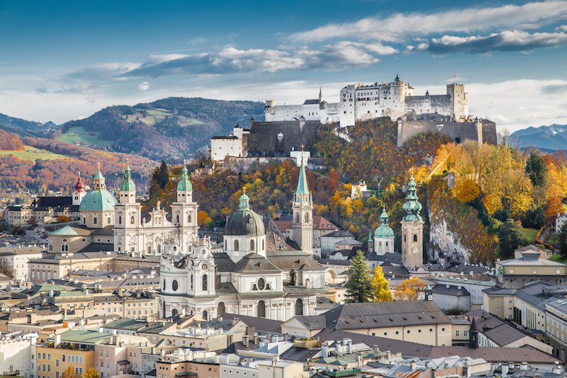
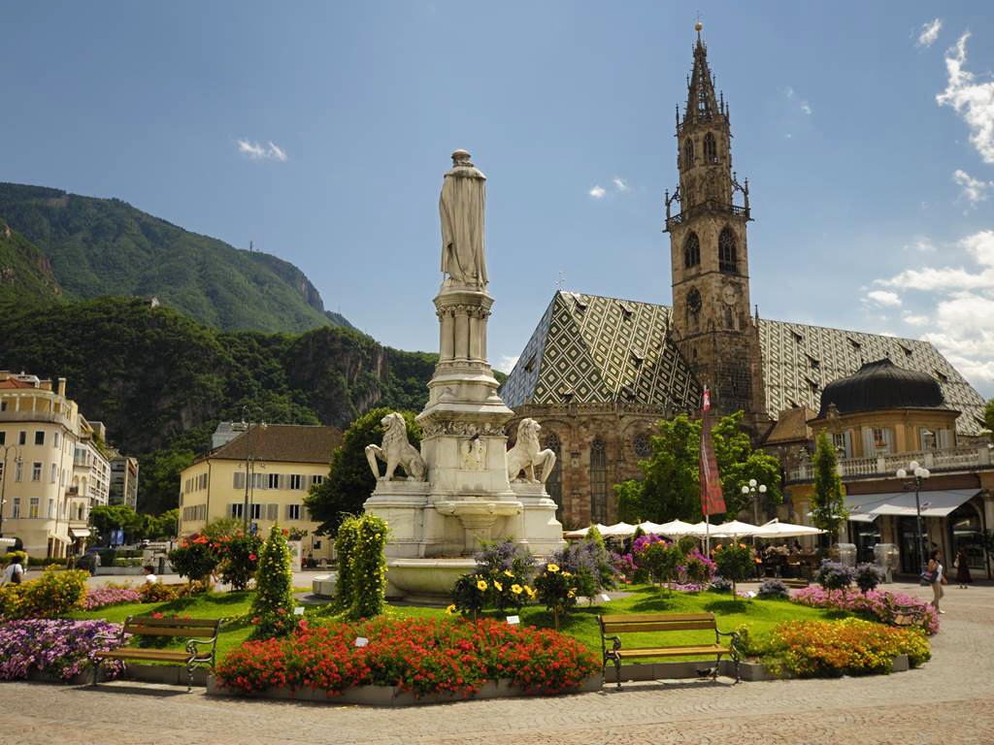
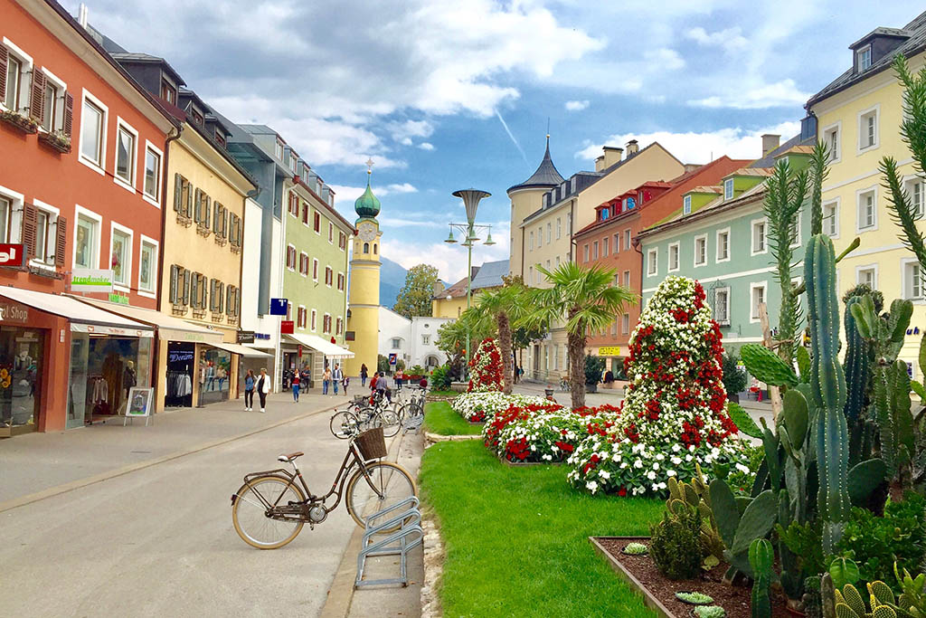
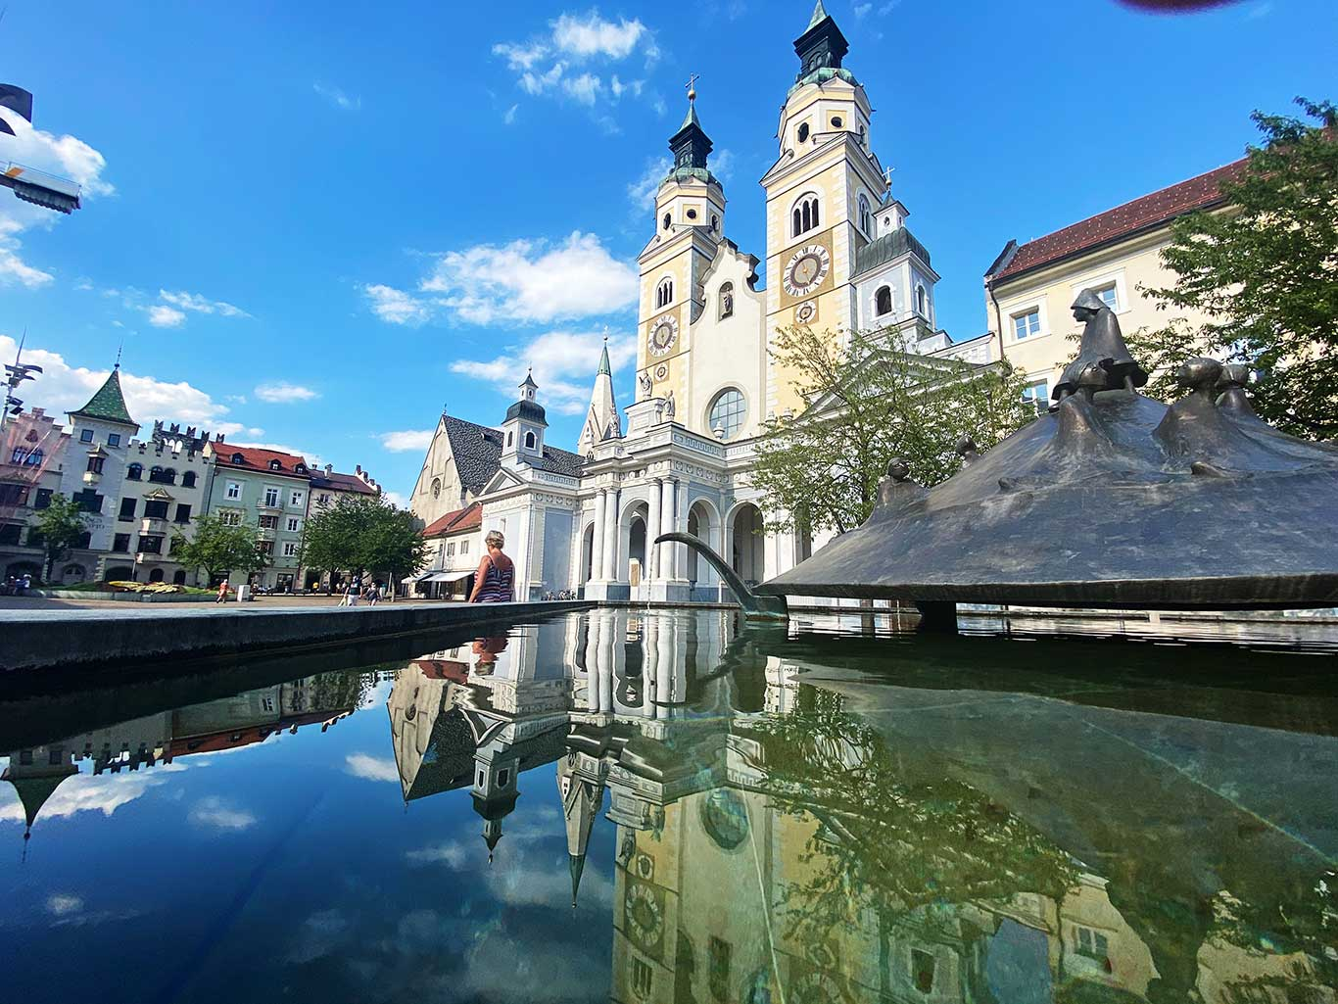
ITALY JULY 19th – JULY 30th 2024 ITALY: Brixen – Bozen – Venice Italian Alps (Mountains) AUSTRIA: Salzburg - Lienz

Slide 2
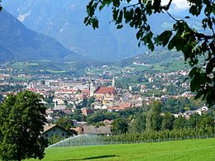
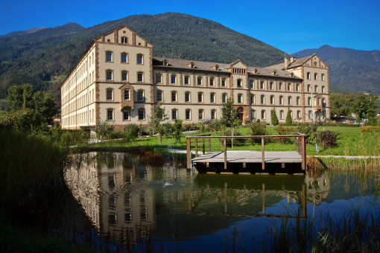
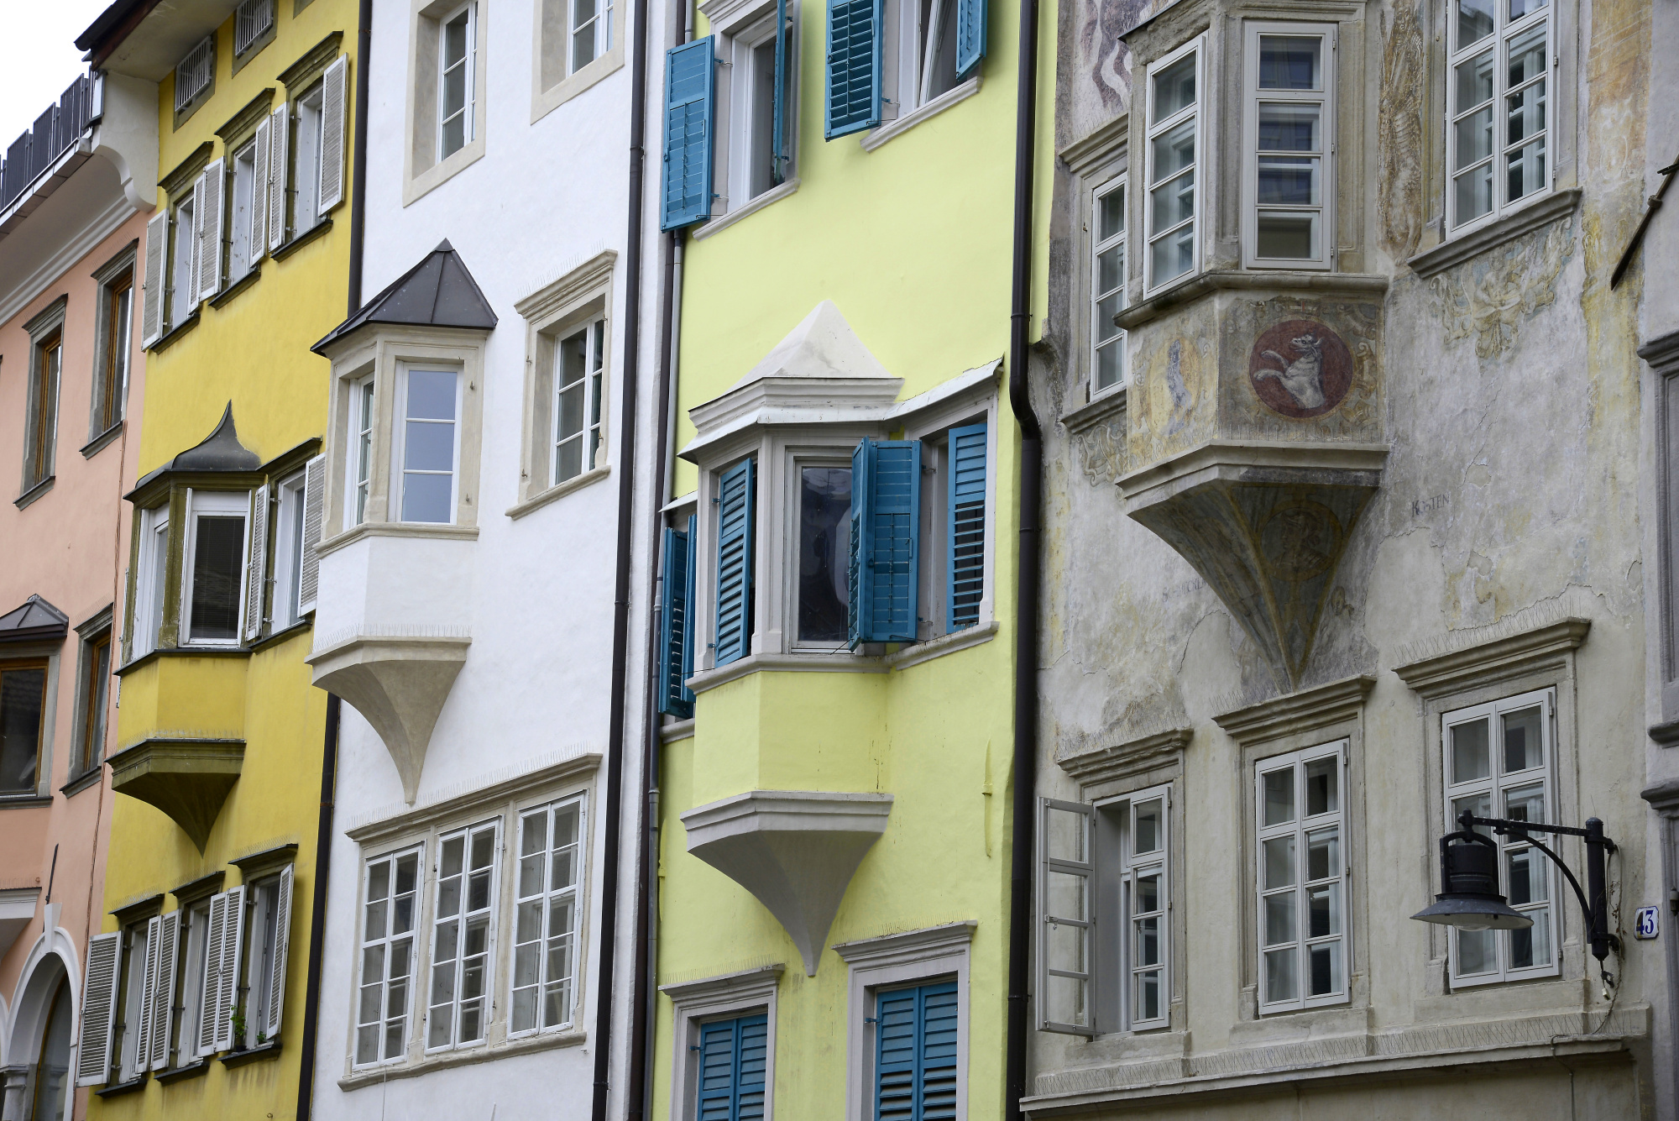
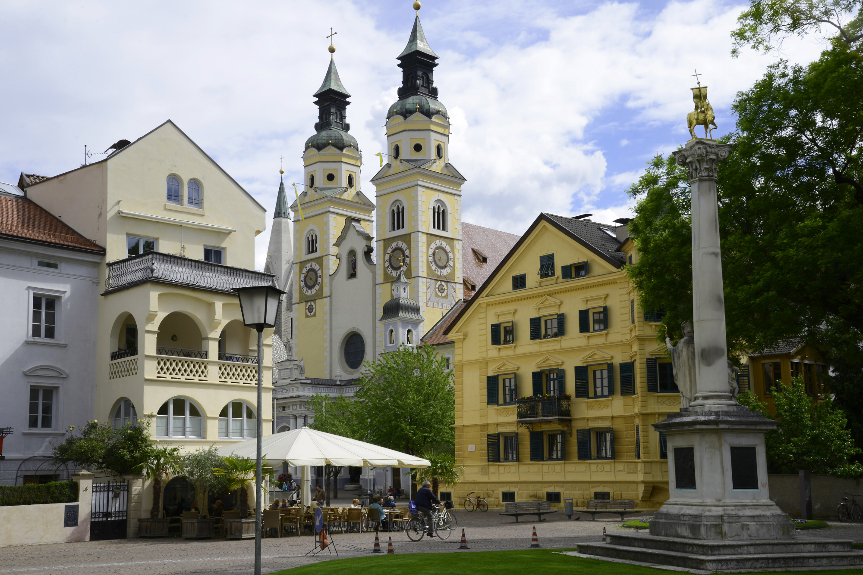
City of Brixen, Northern Italy
Brixen, Bressanone in Italian language, is a very nice town in the Isarco Valley (northern Italy)… a special mix of Nordic and Mediterranean traits.
With its rich and elegant historic center and its nearby beautiful surroundings, this town always amazes its visitors.
Brixen lies between Bozen and Vipiteno, among vineyards and orchards, surrounded by the Alps in a flourishing and very pleasant environment, always with the perfect weather, never too hot and always pleasant
Brixen offers a huge variety of possibilities to tourists.
This old city is full of history, interesting locations and monuments to visit, leisure and cultural activities
The beautiful German College for students will host our group ensuring a pleasant and well-kept environment, in an intimate and familiar atmosphere.
We will have rooms at our disposal, well equipped for artistic and music activities During our Masterclass (led by conservatory qualified professors) we will have access to rooms with pianos and to a a splendid concert hall for our concert and music lessons.
Our program will be enriched with two concerts

Slide 3
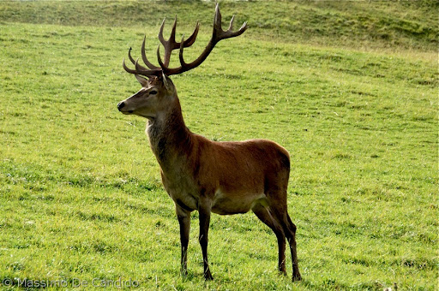
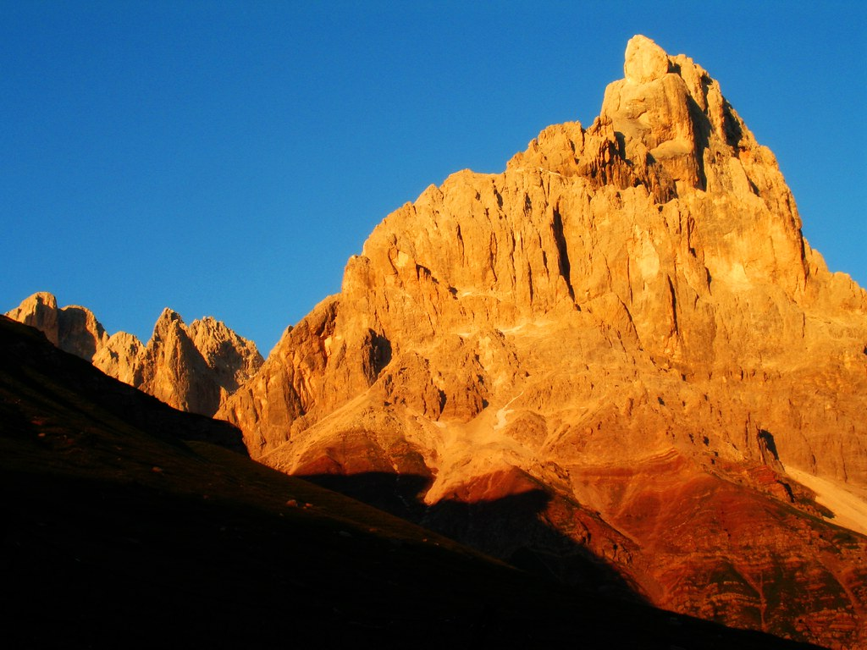
Plose Paneveggio Alps
In one of our excursions we will visit the nearby mountain: the Dolomites and the Alps
We will be going up with the new cable car; once we conquer the top, we will enjoy some walking and breathtaking views in the middle of the mountains.
The excursions are designed for everyone and their ease does not exclude any of us!
Odle and Pale di San Martino will be part of what we see, providing us with an unforgettable glance.
On the top of this, another highlight will be visiting the area of Paneveggio, where will find an important museum «The sounds of Nature». Here, to the singing of birds from all over the world, we will study how musical instruments were made. You can also listen to special recordings with headphones.
We will continue on foot to see native animals such as deer, arriving at another wonderful mountain view: the Pale di San Martino. If we are lucky, we will see the effects of sunset, when the sun gives the mountains a magical red color like fire.

Slide 4
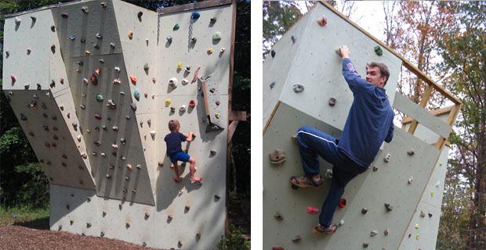
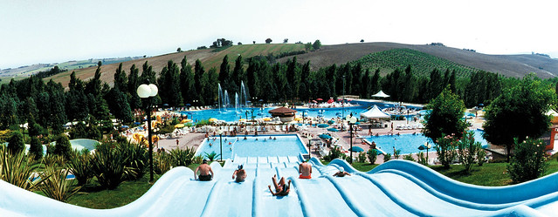
Relax day
Brixen offers a pleasant walk along its beatiful river which crosses the town.
Enjoy the view of the majestic main Cathedral ….
But don’t forget to get some time in the famous «WATER PARK», where you’ll have your best time in the famous «indoor and outdoor swimming pools of this city».
It’ll be possible to try the climbing wall and other sport activities included in the water park.

Slide 5
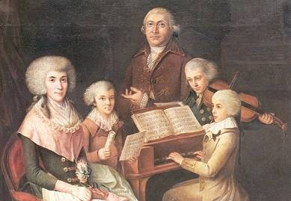
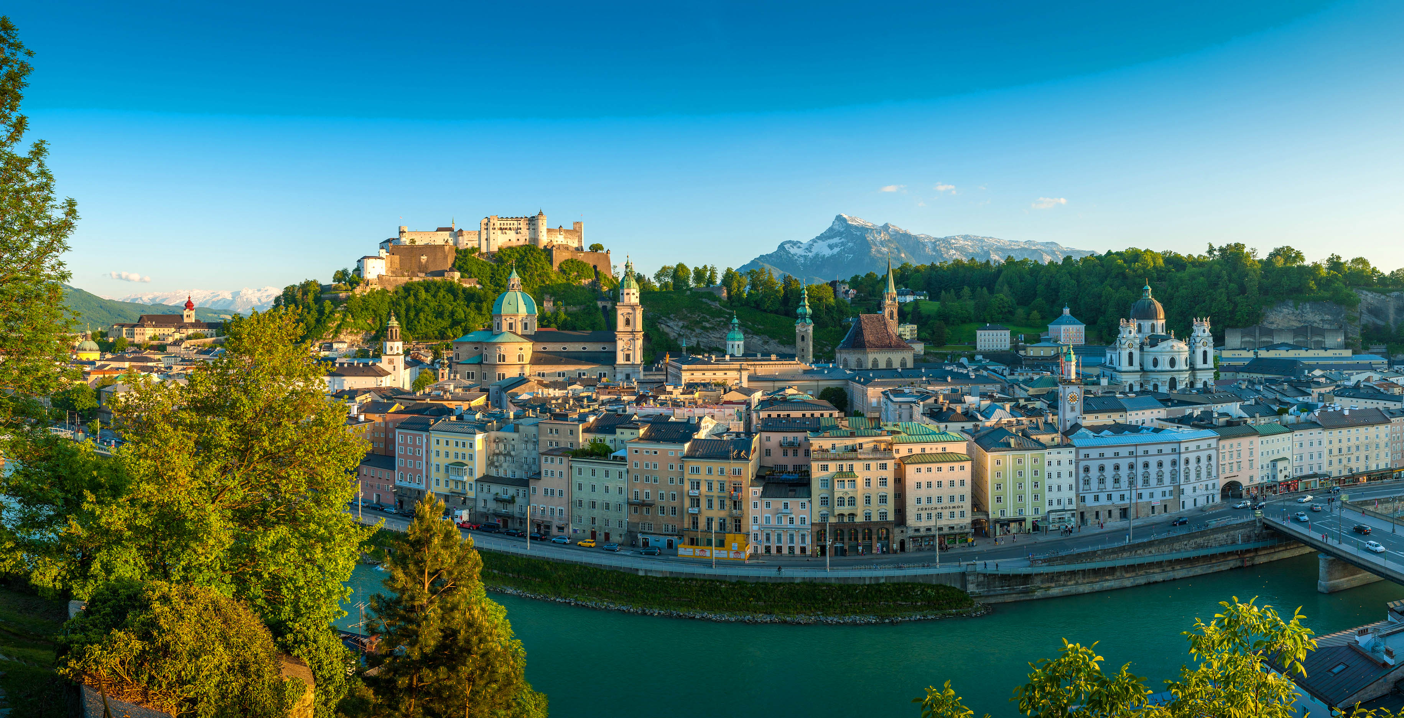
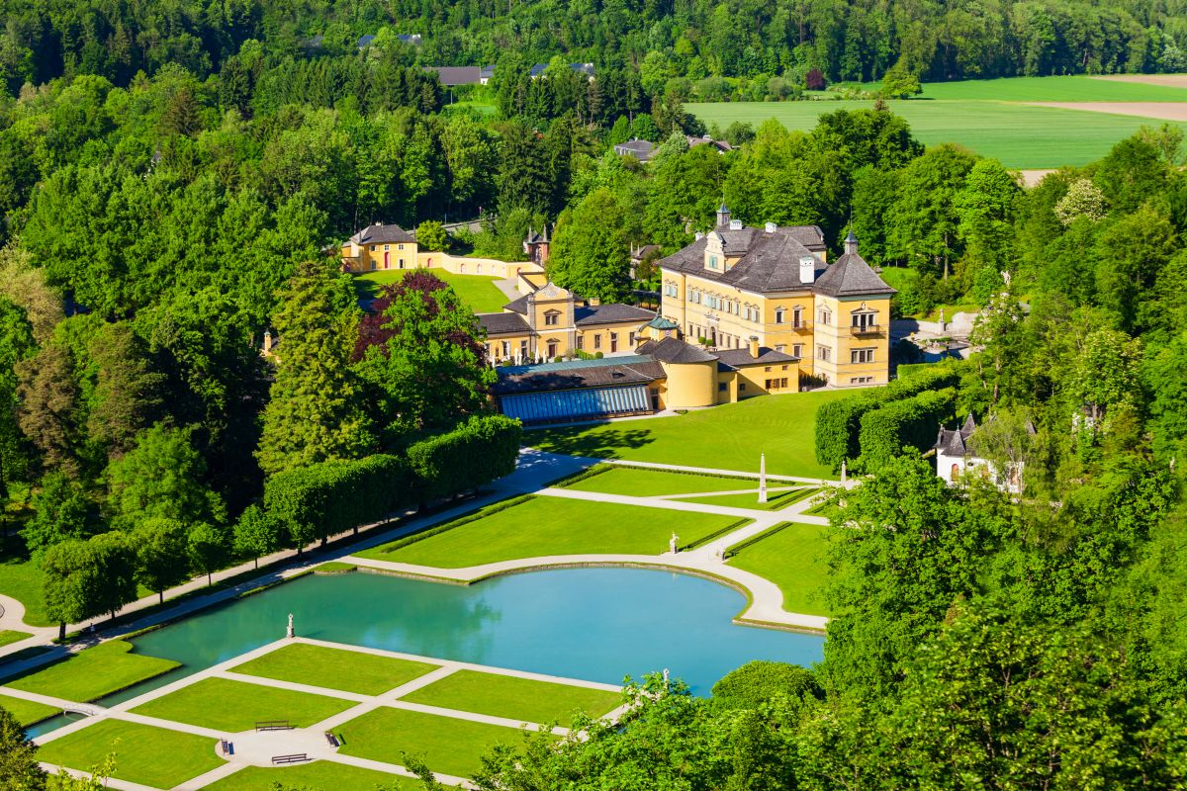
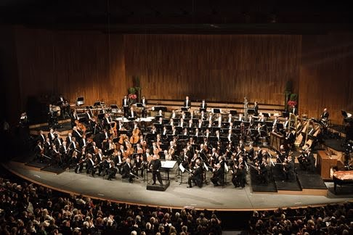
Salzburg (Austria)
From Brixen we will drive to Salzburg, crossing the ITALY – AUSTRIA border, for a 2 days immersion in one of the most famous austrian cities, which hosted Mozart’s birth place.
We will visit Mozart’s birthplace, Salzburg’s fortress and the whole historic center.
Enjoy visiting this city both for its historical monuments and for the Music Experience.

Slide 6
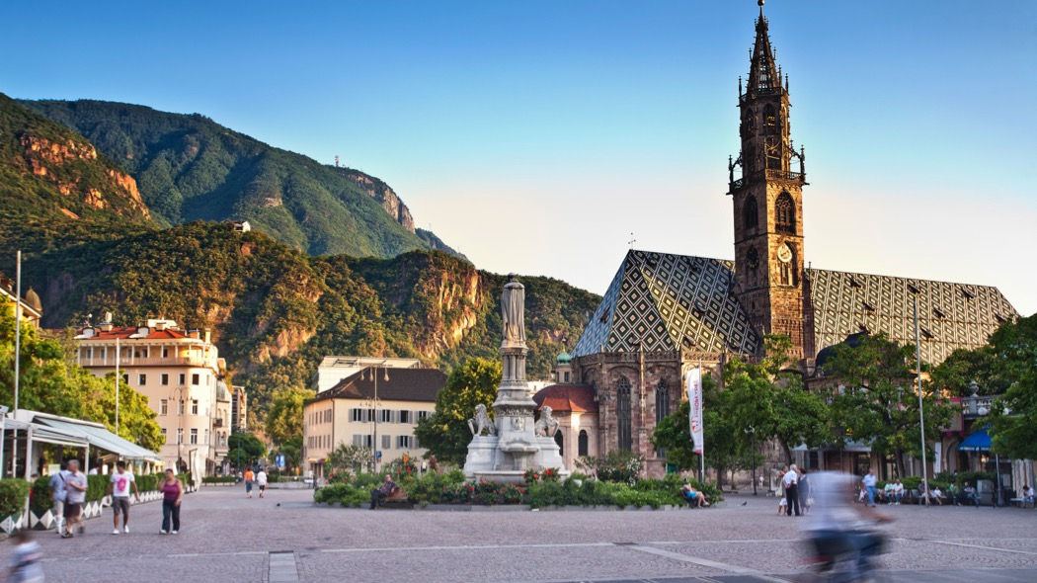
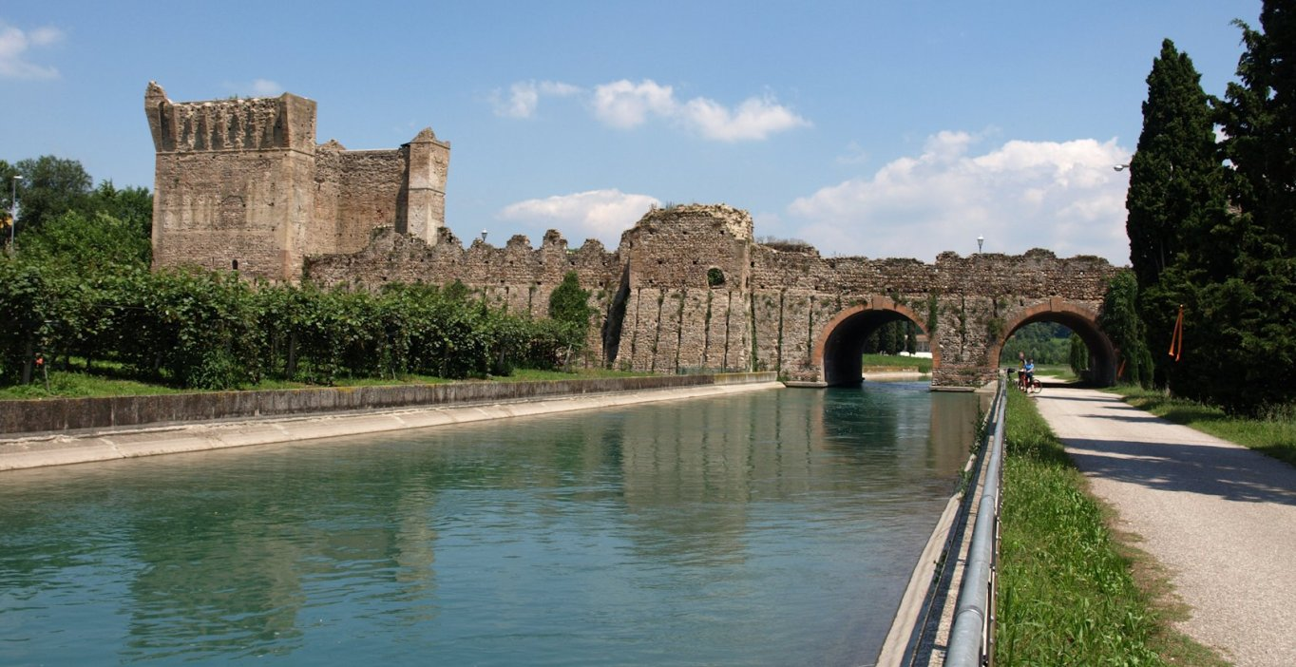
SAN CANDIDO – LIENZ … a very exciting ciclyng path
Don’t miss out this unforgettable experience.
Let us give you the possibility to enjoy a very feasible exciting cycling path.
You will be provided with your bike to cycle along a very safe and beautiful cycling path, which connects San Candido (Italy) to Lienz (Austria)
After completing the excursion, you will be driven back to relax in your hotel in Bozen.
Stay in Bozen for 2 days.
This city offers a wonderful city center, with nice pedestrian zones, restaurant and entertainment… museums, cathedrals adn monuments.
Just think that the lifestyle and standard of living in this city is recognized as the highest and best in Italy
***if you prefer, you can ask (when booking) for an electric bike (with a small supplement)
*** If you don't want to go on our bike trip, relax in Bolzano (Bosen) and enjoy your free time in this enchanting city

Slide 7
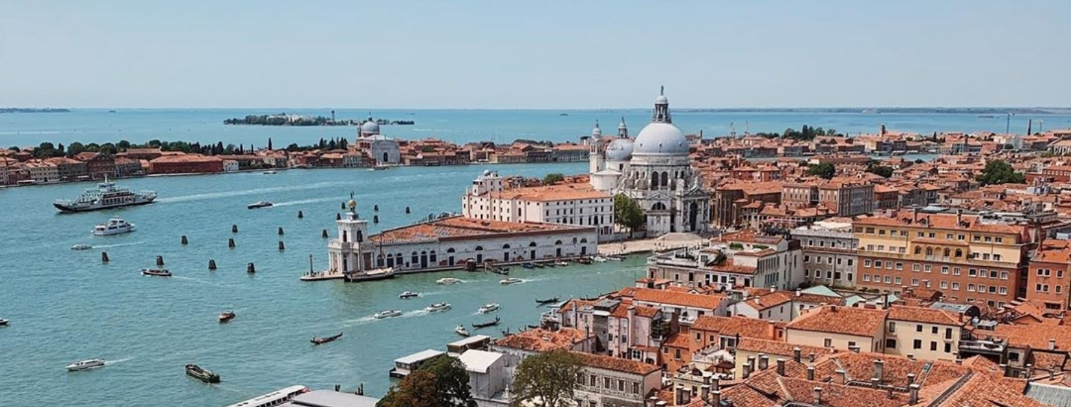
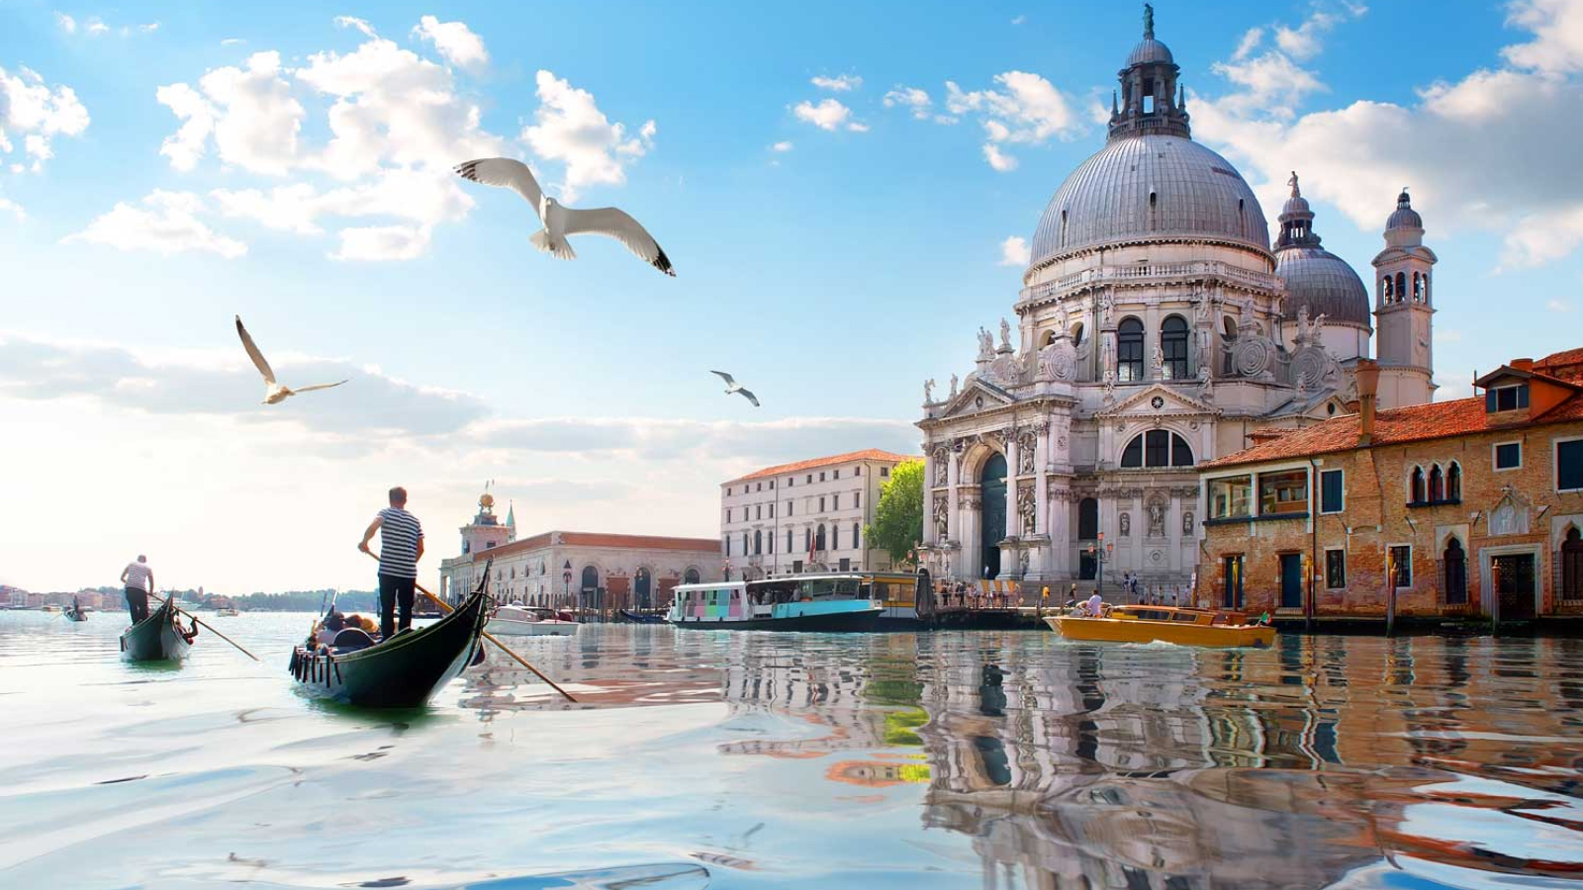
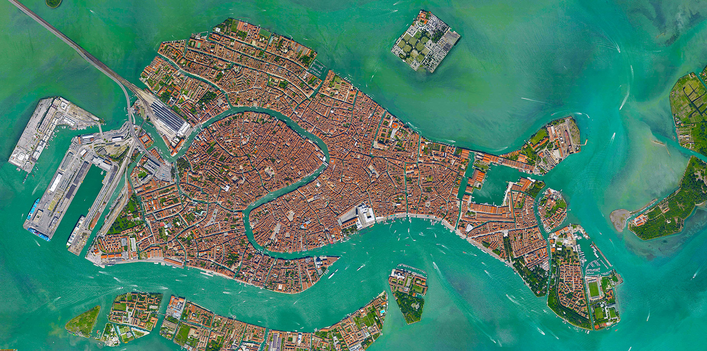
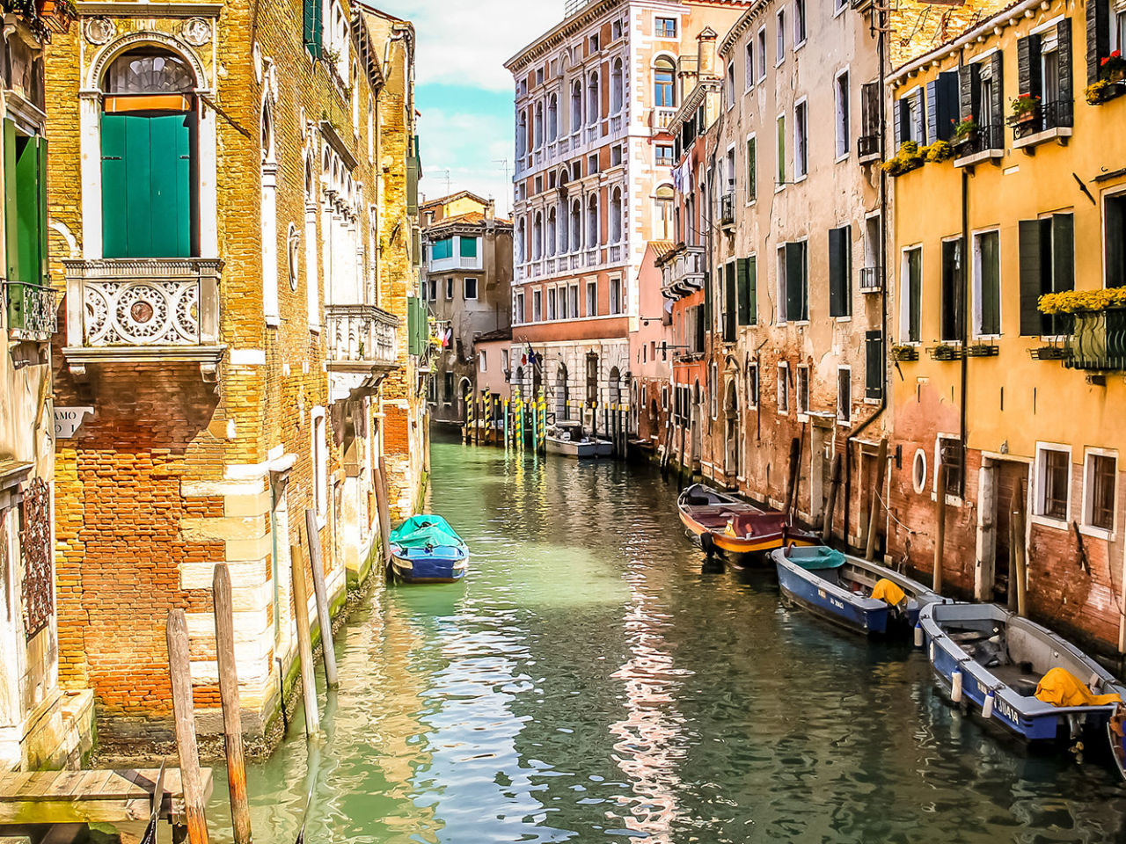
VENICE
As a conclusion of our journey we will take you to Venice and let you enjoy and discover this wonderful city
2 days in Venice and Venice Lagoon
*** Further extensions with extra nights in Venice or/and in other Italian cities are possible – quotation on request

